Slide 1
What is Data Science? What is Machine Learning?

Slide 2
What we have heard....
Netflix has a great recommendation engine telling us which movies to watch when? We hear that data science and machine learning is behind it all.
Our Facebook newsfeed is filled with (mostly) relevant advertisements which generate most of Facebook’s revenue. Again, we hear data science underpins this.
So, what exactly is Data Science? Where does it begin and where does it end? Is machine learning a subset of data science or vice-versa?

Slide 3
Consensus definitions
A vague but wholistic formal definition:
Data science is an interdisciplinary field which unifies concepts of “statistics, data analysis, machine learning and other related methods” with to goal of “understanding and analysing actual phenomenon” with data. (Hayashi Chikio, 1998)
In my words:
Data science is the process of programmatically summarizing or inferring from data using modern machine learning algorithms and statistical techniques.

Slide 4
Consensus definitions
The term “machine learning” was used in both definitions. Let’s again use a formal definition and then a looser interpretation.
According to Tom Mitchell, famous computer scientist at Carnegie Melon, “ A computer program is said to learn from experience E with respect to some class of tasks T and performance measure P, if its performance at tasks in T, as measured by P, improves with experience E. ”
My definition: Machine learning refers to the autonomous identification of useful patterns in data whereby this identification is improved with respect to some feedback or error.

Slide 5
Let’s give some volume to the scant definitions
What are the statistical techniques spoken of: Linear Regression, Logistic Regression, Regularization and more
Machine Learning Algorithms: Decision Trees, Support Vector Machines, Single-layer Neural Networks and more
While both techniques can give similar outputs, there are tradeoffs.
Statistical techniques are simpler, provide for easy interpretation, and are relatively computationally inexpensive.
On the other hand, machine learning algorithms scale well for large amounts of data and do better with tasks like image recognition.

Slide 6
Types of Machine Learning
There are 4 main types of machine learning:
- Supervised Learning: Training data set includes desired outputs (Labels included)
- Unsupervised Learning: Training data set does not include desired outputs (no labels included)
- Semi-Supervised Learning: Training data includes a few desired outputs
- Reinforcement Learning: Rewards from sequence of actions

Slide 7
Where does Data Science start?
Collection of data is NOT strictly a part of data science. Data collection, web scraping and storing data in databases comes under data engineering.
Once we have a file (Excel, CSV, log file etc) or database that is when we are truly in the realm of data science.
Now, our tasks may include data cleaning, data visualization, data exploration, feature engineering, model evaluation and variants of prediction and analysis for insights or as part of a larger product.
Web-development, server-side computing and the infrastructure that may support data science work is NOT strictly a part of data science

Slide 8
So, what are we going to do?
In this course, we are going to learn about where and how Python helps in data science and machine learning.
We will also be learning the inner workings of two commonly used supervised learning techniques for both numerical prediction and classification.
We will engage with statistical theory as well as grapple with Python for computation.
We will go through exciting, real-world data sets to practice. The course will also define challenges designed to test understanding and implementation of all the learned concepts in a real-world context.

Slide 9
Other courses in the series
Intermediate Data Science: Old and Recent Supervised Methods
Dealing with Text Data: Natural Language Processing
Advanced Data Science: Unsupervised and Deep Learning
Practical Deep Learning Course

Slide 10
Pre-requisites
Intermediate level Python
Understanding of inferential and descriptive statistics
Basic Linear Algebra

Slide 11
Let’s Say...
Device_Class | Patient_Blood_Pressure | Patient_Red_Blood_Cell_Count | etc.
0 | 120/80 | 4.33 million | etc.
2 | 160/100 | 6.1 million | etc.
etc. | etc. | etc. | etc.

Slide 12
Let’s Say...
A statistician would stare at the table and ask himself or herself? What model should I use to approximate the relationship between the choice of device and the various variables? The consequent output may be:
For a computer scientist, the data are not thought in terms of having been generated by that model. Instead, the primary concern is to identify the algorithm to learn the best segmentation of patients by device class.
Y_{approx.} = B₁X₁ + B₁X₂ + … + B_{n}X_{n}

Slide 13
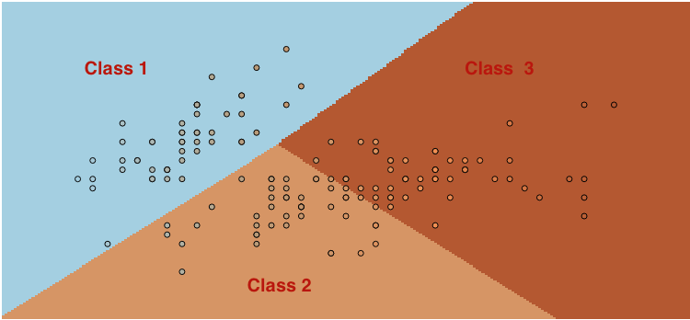
Same Output, Different Approaches
Notes:
So the output is such a plotting where we have three classes of devices under which we have patients they are appropriate for. Very similar or even the same predictions for medical device were made for each patient. However, at this stage, the main difference I am trying to highlight is one of approach. Indeed, machine learning algorithms are being more rapdily developed than their statistical counterpart and there is a legitimate arguement to be had where ml algos are more powerful and scalable.

